Slide 1
House Price Prediction
Capstone
Enoch Adogla
4-30-2022

Slide 2
Introduction
Problem Statement
Knowing house prices is very important to both a home buyer and seller. Because each party would want to get the best deal, the price cannot be too high or too low. The banks would also do due diligent in order not to finance an over valued house. It is therefore imperative for both a buyer and seller to get an acceptable appraisal for the house, which would be agreeable to all parties in the transaction. A number of factors affect home prices are: the economy, the number of houses of similar kind sold in the area in the recent past, features on the house, and their present condition.
Need of the study
Having data from house sales at several communities would be vital in building machine learning models that can predict house prices. This would apprise financial institutions as to when to send out offers of refinance to home owners , allow home sellers and buyers to have a good estimate of homes, in order not to pay for home appraisal at random, unless the banks demand one. This study can be leveraged by the company to make available home values at cheaper cost to homeowners, buyers and financial institutions.

Slide 3
Data Overview
Data was collected from houses sold from May 2, 2014 to May 27, 2015
The oldest house sold was built in 1900 and the newest in 2015
21613 house sales; 177 houses sold more than once
Target variable: price; 22 predictor variables
Data type is both numerical and categorical
Missing values constitute less than1% of data
No duplications were found

Slide 4

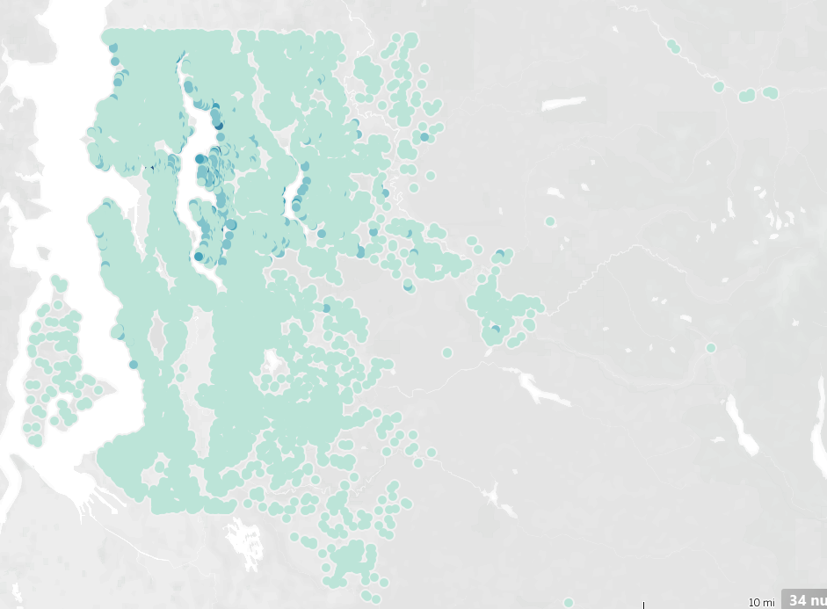
Density Of House Sales
Most house sales are concentrated around the city centers of Seattle and Bellevue
The darker the color, the higher the price of the house
The expensive houses are mostly in the higher latitudes

Slide 5
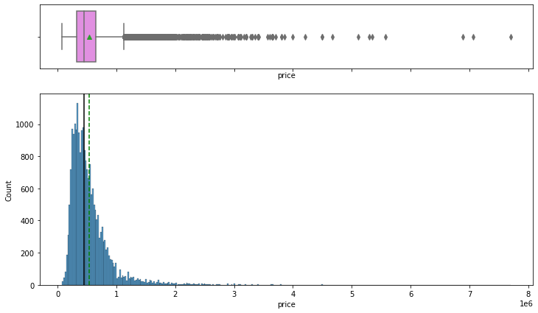
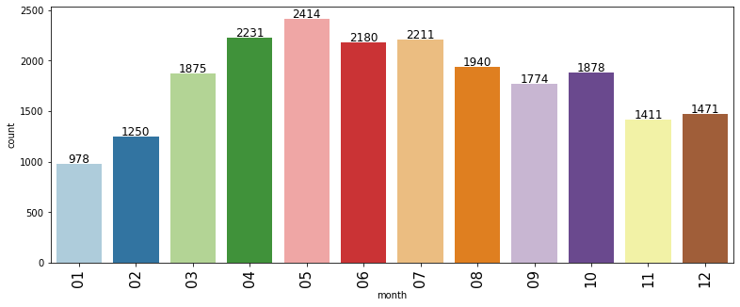
Univariate Analyses
The house price distribution is right skewed
The minimum price is $75,000 and maximum is $7,700,000
The mean price is ~540,000 and median is ~450,000
There are more sales in the month of April and May than in
other months
The winter months – November, December January have the
lowest monthly sales

Slide 6
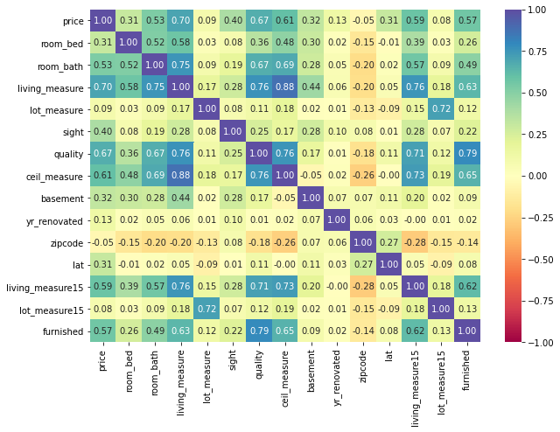
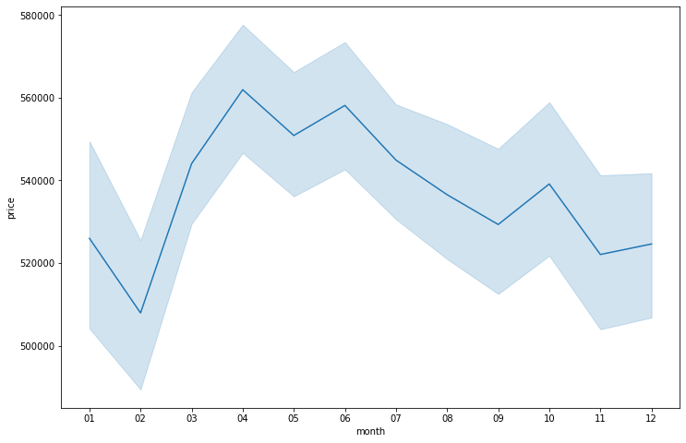
Bivariate Analyses
Houses prices are lower from November to February
House prices peak from April to June
Some attributes that strongly correlate with home prices (corr>5) are: furnished, living_measure, living_measure15 ceil_measure and quality.

Slide 7
Data Preparation: Missing Value Imputation, Feature Engineering
dayhours column was split into two columns, months and year. Day dropped
zipcode grouped into only two, using the first 3 digits – 980 and 981
Missing values filled with median
Only 4% of all houses showed renovation dates. The rest were filled with the median of yr_built
All outliers were removed
Price converted to logprice (logarithm of price)

Slide 8
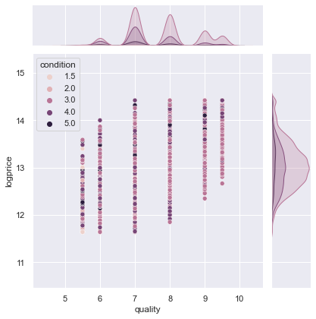
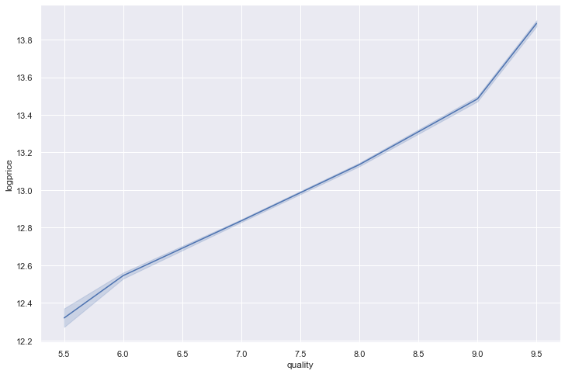
logprice vs quality
logprice vs quality vs condition
Lowest quality rating for a house is 5; highest 9
The higher the rating, the higher the price
Condition has no effect on the quality

Slide 9
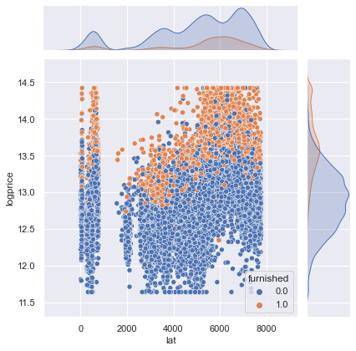
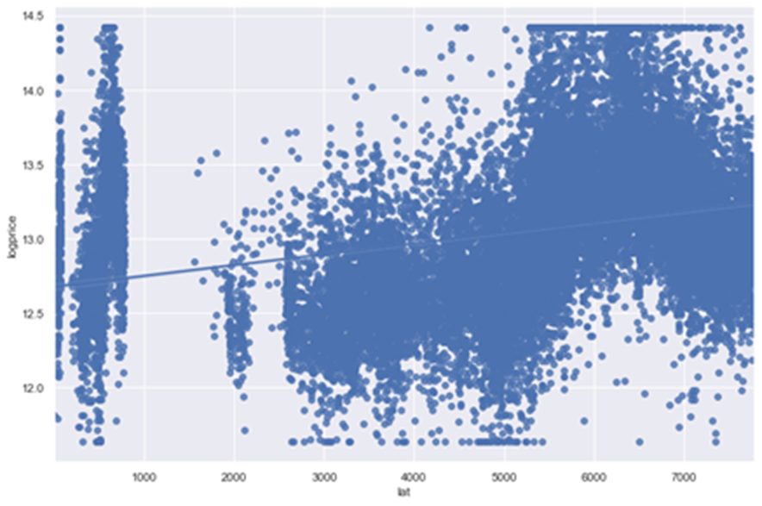
logprice vs latitude
logprice vs latitude vs furnished
Most furnished houses are in the higher latitudes

Slide 10
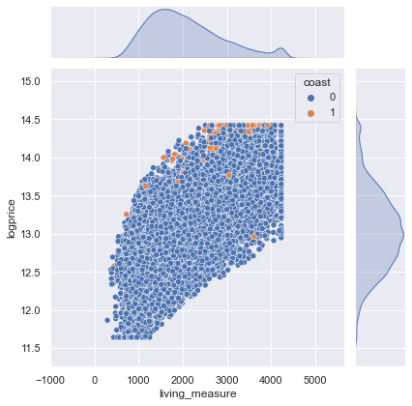
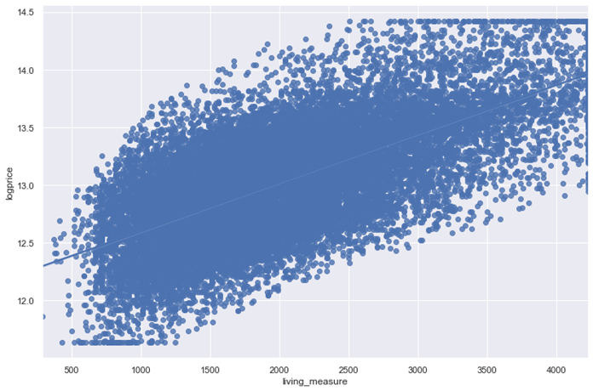
logprice vs living measure
logprice vs living measure vs coast
The larger the house, the higher the price of the house
There are only 161 (0.74%) water front houses
They are mostly big and expensive

Slide 11
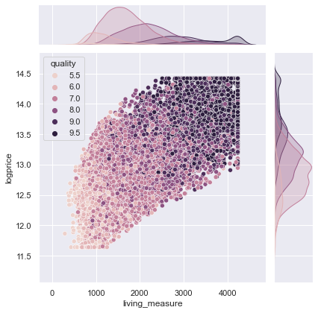
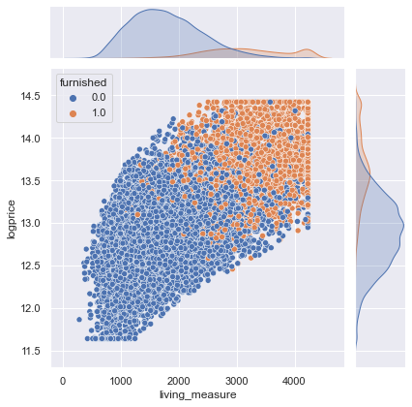
logprice vs living_measure vs quality
logprice vs living_measure vs furnished
The darker the spot, the higher the rating
Larger houses have higher ratings than the smaller houses
Most of the furnished homes are big homes

Slide 12
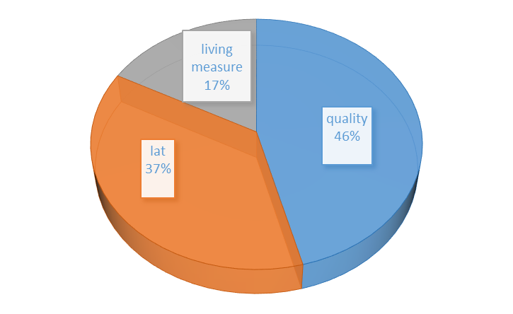
Models Perfomance Metrics
Primary predictors of house prices
From the Decision Tree model’s feature importances, 3 factors account for 80% variation in house prices
Data was split into train and test sets (70:30)
Decision Tree is the best model
99.9% chance of correctly prediction house prices
RMSE and MAE at least100 times better than other models

Slide 13
Business Insights And Recommendations
The most significant predictors of house prices in decreasing order are: quality, latitude and living_measure
The quality rating alone accounts for ~36% of the price variations, and the higher the rating in the range (5-9), the higher the price. House sellers should therefore consider doing a facelift of the property before listing. On the other hand, those looking for a low-budget houses should consider those in low-medium rating but are in likable condition
House prices increase generally with increasing latitude, and accounts for nearly 30% of price variations. New property builders seeking to maximize profits should consider building on the high latitudes, while low-budget buyers should be looking into the lower latitudes for houses. Even water front properties on the lower latitudes are relatively cheaper
The living measure or the square footage accounts for 15% of the variation in the house prices
Information needed on the description of the locations, such as urban, suburban, rural, and nearness to schools and industry to explain the price variation with latitude
The model can be deployed by developing questions on the features of houses, that when completed online will immediately predict the price of a house

